Slide 1
Email Spam Detector
Machine Learning Project. Built with Python and Streamlit
Nitin I
Saurav Kumar Yadav

Slide 2
Naive Bayes Algorithm
Step 1
Data Preprocessing
A naive Bayes classifier is an algorithm that uses Bayes' theorem to classify objects. Naive Bayes classifiers assume strong, or naive, independence between attributes of data points.
Popular uses of naive Bayes classifiers include spam filters, text analysis and medical diagnosis. These classifiers are widely used for machine learning because they are simple to implement.
Step 2
Training the Model
Step 3
Predicting results
Step 4
Checking Performance
Step 5
Visualization

Slide 3
DATA PREPROCESSING
Importing the libraries and Dataset

Slide 4
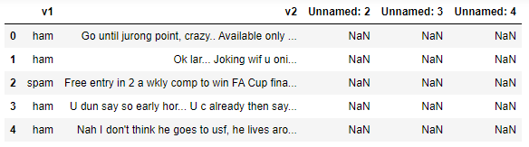
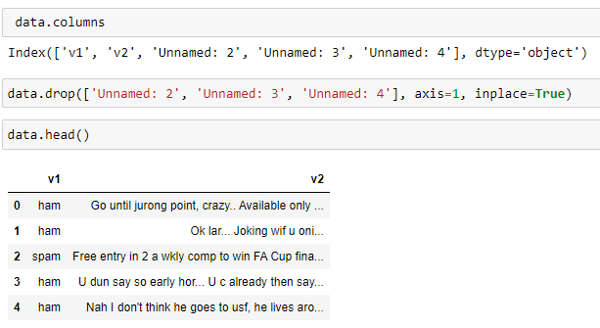
Data Cleaning
Data present previously
Data after cleaning->

Slide 5
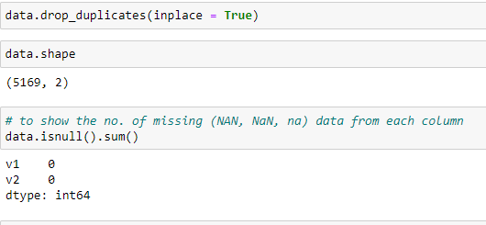
Data cleaning contd…
Now we delete the duplicate values present and check if the presence of null values and we also clean the missing values using the drop_duplicates after that we check the presence of values NAN, NaN, na.

Slide 6
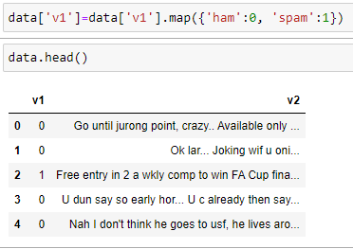
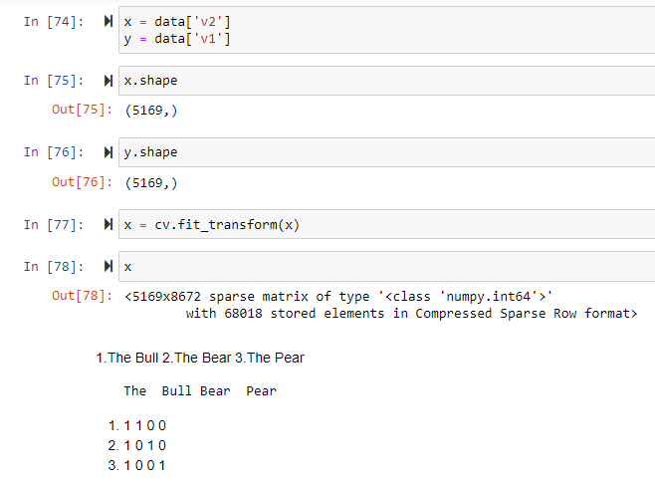
Data Mapping
After cleaning the data we now map the trained data into ham and spam and now test the cases.
Testing of sparse matrix using Vectorizer and then transforming the compressed data into matrix format.

Slide 7
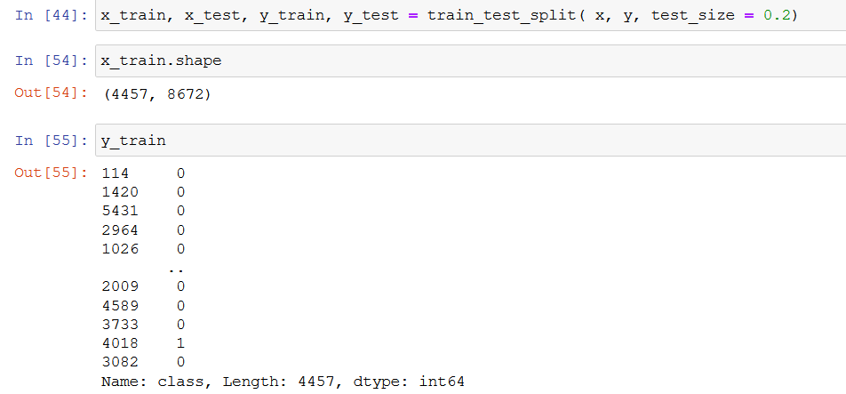
TRAINING AND TEST SETS

Slide 8
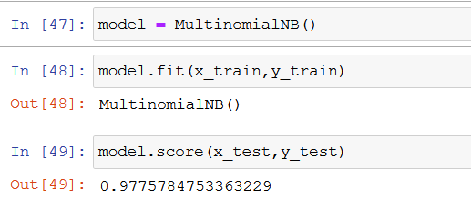
TRAINING MODEL AND PREDICTING RESULTS

Slide 9
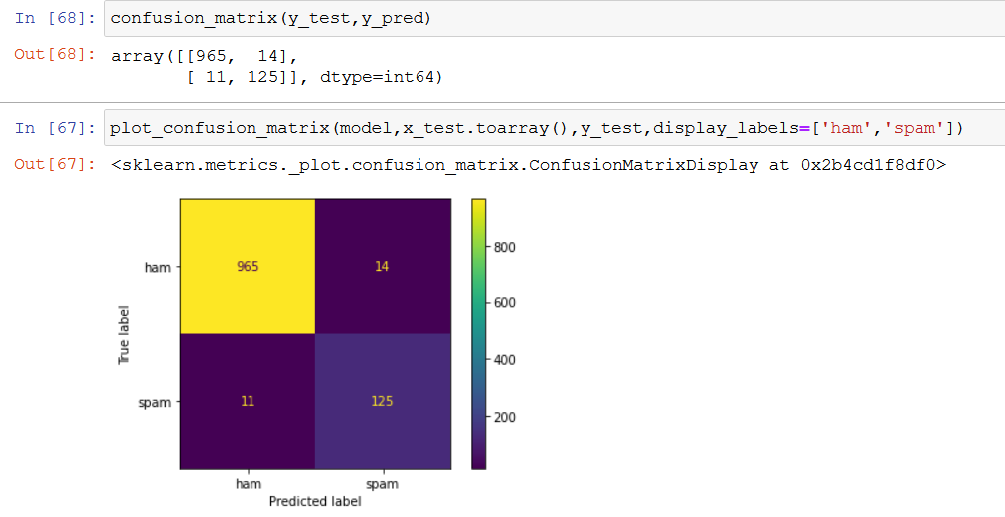
CONFUSION MATRIX

Slide 10
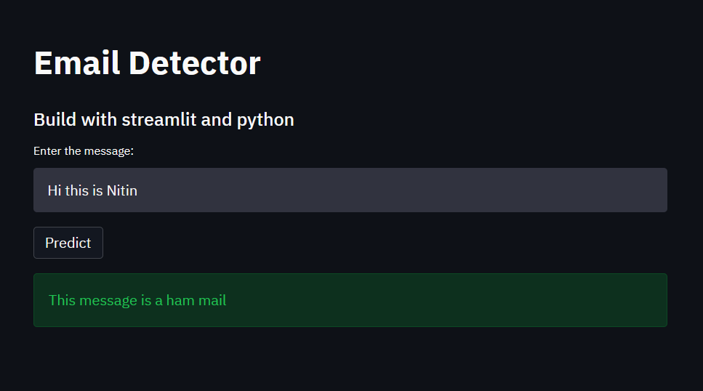
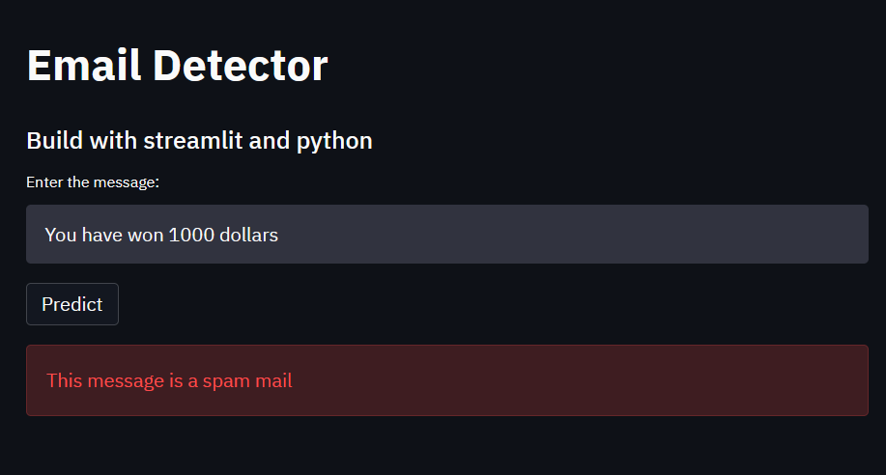
STREAMLIT WEBPAGE

Slide 11
Thank You

